Slide 1


Combating Cyber crimes- Law & Enforcement in India
The 'Diamond Jubilee Celebration Conference of CIRC'.
Kanpur ,5th July, 2008
Karnika Seth, Partner & Cyber Lawyer
SETH ASSOCIATES
ADVOCATES & LEGAL CONSULTANTS
Copyright© Seth Associates 2008

Slide 2

Introduction to Cyber crime
Computer Crime, E-Crime, Hi-Tech Crime or Electronic Crime is where a computer is the target of a crime or is the means adopted to commit a crime.
Most of these crimes are not new. Criminals simply devise different ways to undertake standard criminal activities such as fraudMost of these crimes are not new. Criminals simply devise different ways to undertake standard criminal activities such as fraud, theftMost of these crimes are not new. Criminals simply devise different ways to undertake standard criminal activities such as fraud, theft, blackmailMost of these crimes are not new. Criminals simply devise different ways to undertake standard criminal activities such as fraud, theft, blackmail, forgeryMost of these crimes are not new. Criminals simply devise different ways to undertake standard criminal activities such as fraud, theft, blackmail, forgery, and embezzlementMost of these crimes are not new. Criminals simply devise different ways to undertake standard criminal activities such as fraud, theft, blackmail, forgery, and embezzlement using the new medium, often involving the Internet

Slide 3

Computer vulnerability
Computers store huge amounts of data in small spaces
Ease of access
Complexity of technology
Human error
One of the key elements that keeps most members of any society honest is fear of being caught — the deterrence factor. Cyberspace changes two of those rules. First, it offers the criminal an opportunity of attacking his victims from the remoteness of a different continent and secondly, the results of the crime are not immediately apparent.
Need new laws and upgraded technology to combat cyber crimes

Slide 4
Types of Cyber crimes
Credit card frauds
Cyber pornography
Sale of illegal articles-narcotics, weapons, wildlife
Online gambling
Intellectual Property crimes- software piracy, copyright infringement, trademarks violations, theft of computer source code
Email spoofing
Forgery
Defamation
Cyber stalking (section 509 IPC)
Phising
Cyber terrorism
Crime against Government
Crime against property
Crime against persons

Slide 5
Computer Viruses
Viruses
A computer virus is a computer program that can infect other computer programs by modifying them in such a way as to include a (possibly evolved) copy of it. Note that a program does not have to perform outright damage (such as deleting or corrupting files) in order to be called a "virus".
Viruses
File
infectors
Boot record
infectors
Boot and
file
viruses

Slide 6
Cyber crimes
Web jacking
Hacking
Information
Theft
E-mail
bombing
Salami
attacks
Denial of
Service
attacks
Trojan
attacks

Slide 7

Combating cyber crimes
Technological measures-Public key cryptography, Digital signatures ,Firewalls, honey pots
Cyber investigation- Computer forensics is the process of identifying, preserving, analyzing and presenting digital evidence in a manner that is legally acceptable in courts of law.
These rules of evidence include admissibility (in courts), authenticity (relation to incident), completeness, reliability and believability.
Legal framework-laws & enforcement

Slide 8
International initiatives
Representatives from the 26 Council of Europe members, the United StatesRepresentatives from the 26 Council of Europe members, the United States, CanadaRepresentatives from the 26 Council of Europe members, the United States, Canada, JapanRepresentatives from the 26 Council of Europe members, the United States, Canada, Japan and South Africa in 2001 signed a convention on cybercrime in efforts to enhance international cooperation in combating computer-based crimes. The Convention on Cybercrime, drawn up by experts of the Council of Europe, is designed to coordinate these countries' policies and laws on penalties on crimes in cyberspace, define the formula guaranteeing the efficient operation of the criminal and judicial authorities, and establish an efficient mechanism for international cooperation.
In 1997, The G-8 Ministers agreed to ten "Principles to Combat High-Tech Crime" and an "Action Plan to Combat High-Tech Crime."
Main objectives-
Create effective cyber crime laws
Handle jurisdiction issues
Cooperate in international investigations
Develop acceptable practices for search and seizure
Establish effective public/private sector interaction

Slide 9
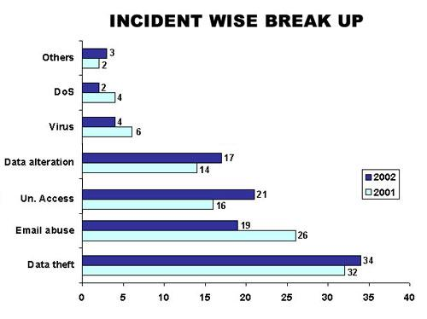
Frequency of incidents of Cyber crimes in India
Denial of Service:
Section
43
Virus: Section:
66, 43
Data Alteration:
Sec. 66
U/A Access
: Section 43
Email Abuse
: Sec. 67,
500, Other IPC Sections
Data Theft
: Sec 66, 65
Source: Survey conducted by ASCL
‹#›
‹#›

Slide 10
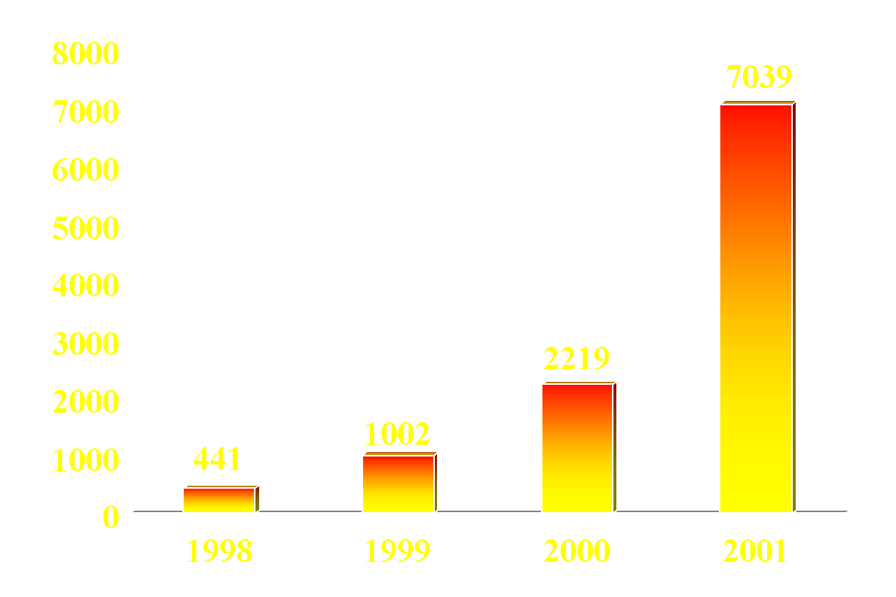
No. of Indian web-sites defaced
‹#›

Slide 11
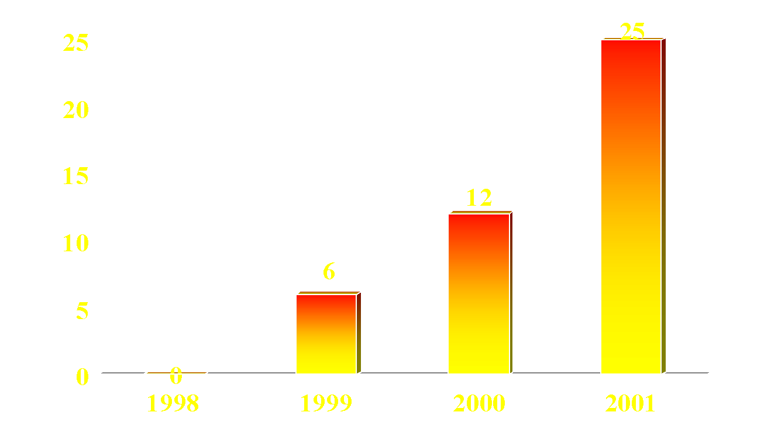

_{Number of Indian sites hacked}
_{Site of BARC-panic all around}
‹#›

Slide 12
REPORTED CASES
•
State versus
Amit Pasari
and
Kapil Juneja
•
Delhi Police
–
M/s
Softweb
Solutions
–
Website
www.go2nextjob.com
hosted
–
Complaint of hacking by web hosting service
•
State versus Joseph Jose
–
Delhi Police
•
Hoax Email
-
Purported planting of 6 bombs in
bombs in Connaught Place
•
State
versus Aneesh
Chopra
–
Delhi Police
•
Three company websites hacked
•
Accused: An ex
-
employee
•
State versus K R
Vijayakumar
–
Bangalore
Cyber Crime Police Station, 2001
•
Criminal intimidation of employers and crashing the company’s
server
•
Phoenix Global solutions
–
‹#›
‹#›

Slide 13
2001 CSI/FBI
Computer Crime and Security Survey
Of the organizations suffering security compromises in the last
year
–
95% had Firewalls and 61%had
IDSs
1998
1999
2000
2001
SECURITY TECHNOLOGIES
%
%
%
%
USED
Intrusion Detection Systems
35
42
50
61
Firewalls
81
91
78
95
Encrypted Files
50
61
62
64
Anti
-
virus software
96
98
100
98
Access Control
89
93
92
90
•
False sense of security
–
“We already have a Firewall”
‹#›

Slide 14
What is India inc’s biggest threat?
Cyber crime is now a bigger threat to India Inc than physical crime. In a recent survey by IBM, a greater number of companies (44%) listed cyber crime as a bigger threat to their profitability than physical crime (31%). The cost of cyber crime stems primarily from loss of revenue, loss of market capitalisation, damage to the brand, and loss of customers, in that order. About 67% local Chief Information Officers (CIOs) who took part in the survey perceived cyber crime as more costly, compared to the global benchmark of 50%.

Slide 15
Combating Cyber crime-Indian legal framework
Information Technology Act, 2000-came into force on 17 October 2000
Extends to whole of India and also applies to any offence or contravention there under committed outside India by any person {section 1 (2)}
read with Section 75- Act applies to offence or contravention committed outside India by any person irrespective of his nationality, if such act involves a computer, computer system or network located in India
Section 2 (1) (a) –”Access” means gaining entry into ,instructing or communicating with the logical, arithmetic or memory function resources of a computer, computer resource or network
IT Act confers legal recognition to electronic records and digital signatures (section 4,5 of the IT Act,2000)

Slide 16
Civil Wrongs under IT Act
Chapter IX of IT Act, Section 43
Whoever without permission of owner of the computer
Secures access (mere U/A access)
Not necessarily through a network
Downloads, copies, extracts any data
Introduces or causes to be introduced any viruses or contaminant
Damages or causes to be damaged any computer resource
Destroy, alter, delete, add, modify or rearrange
Change the format of a file
Disrupts or causes disruption of any computer resource
Preventing normal continuance of

Slide 17
Denies or causes denial of access by any means
Denial of service attacks
Assists any person to do any thing above
Rogue Websites, Search Engines, Insiders providing vulnerabilities
Charges the services availed by a person to the account of another person by tampering or manipulating any computer resource
Credit card frauds, Internet time thefts
Liable to pay damages not exceeding Rs. One crore to the affected party
Investigation by
ADJUDICATING OFFICER
Powers of a civil court

Slide 18
Section 46 IT Act
Section 46 of the IT Act states that an adjudicating officer shall be adjudging whether a person has committed a contravention of any of the provisions of the said Act, by holding an inquiry. Principles of audi alterum partum and natural justice are enshrined in the said section which stipulates that a reasonable opportunity of making a representation shall be granted to the concerned person who is alleged to have violated the provisions of the IT Act. The said Act stipulates that the inquiry will be carried out in the manner as prescribed by the Central Government
All proceedings before him are deemed to be judicial proceedings, every Adjudicating Officer has all powers conferred on civil courts
Appeal to cyber Appellate Tribunal- from decision of Controller, Adjudicating Officer {section 57 IT act}

Slide 19
Section 47, IT Act
Section 47 of the Act lays down that while adjudging the quantum of compensation under this Act, the adjudicating officer shall have due regard to the following factors, namely-
(a) the amount of gain of unfair advantage, wherever quantifiable, made as a result of the default;
(b) the amount of loss caused to any person as a result of the default;
(c) the repetitive nature of the default

Slide 20
Section 65: Source Code
Most important asset of software companies
“Computer Source Code" means the listing of programmes, computer commands, design and layout
Ingredients
Knowledge or intention
Concealment, destruction, alteration
computer source code required to be kept or maintained by law
Punishment
imprisonment up to three years and / or
fine up to Rs. 2 lakh

Slide 21
Section 66: Hacking
•
Ingredients
–
Intention or Knowledge to cause wrongful loss
or damage to the public or any person
–
Destruction, deletion, alteration, diminishing
value or utility or injuriously affecting
information residing in a computer resource
•
Punishment
–
imprisonment up to three years, and / or
–
fine up to Rs. 2 lakh
•
Cognizable, Non Bailable,
Section 66 covers data theft aswell as data alteration
‹#›

Slide 22
Sec. 67. Pornography
Ingredients
Publishing or transmitting or causing to be published
in the electronic form,
Obscene material
Punishment
On first conviction
imprisonment of either description up to five years and
fine up to Rs. 1 lakh
On subsequent conviction
imprisonment of either description up to ten years and
fine up to Rs. 2 lakh
Section covers
Internet Service Providers,
Search engines,
Pornographic websites
Cognizable, Non-Bailable, JMIC/ Court of Sessions

Slide 23
Sec 69: Decryption of information
Ingredients
Controller issues order to Government agency to intercept any information transmitted through any computer resource.
Order is issued in the interest of the
sovereignty or integrity of India,
the security of the State,
friendly relations with foreign States,
public order or
preventing incitement for commission of a cognizable offence
Person in charge of the computer resource fails to extend all facilities and technical assistance to decrypt the information-punishment upto 7 years.

Slide 24
Sec 70 Protected System
Ingredients
Securing unauthorised access or attempting to secure unauthorised access
to ‘protected system’
Acts covered by this section:
Switching computer on / off
Using installed software / hardware
Installing software / hardware
Port scanning
Punishment
Imprisonment up to 10 years and fine
Cognizable, Non-Bailable, Court of Sessions

Slide 25
Cyber crimes punishable under various Indian laws
Sending pornographic or obscene emails are punishable under Section 67 of the IT Act.
An offence under this section is punishable on first conviction with imprisonment for a term, which may extend to five years and with fine, which may extend to One lakh rupees.
In the event of a second or subsequent conviction the recommended punishment is imprisonment for a term, which may extend to ten years and also with fine which may extend to Two lakh rupees.
Emails that are defamatory in nature are punishable under Section 500 of the Indian Penal Code (IPC), which recommends an imprisonment of upto two years or a fine or both.
Threatening emails are punishable under the provisions of the IPC pertaining to criminal intimidation, insult and annoyance (Chapter XXII), extortion (Chapter XVII)
Email spoofing
Email spoofing is covered under provisions of the IPC relating to
fraud, cheating by personation (Chapter XVII), forgery (Chapter XVIII)

Slide 26
Computer Related Crimes under IPC
and Special Laws
Sending threatening messages by email
Sec 503 IPC
Sending defamatory messages by email
Sec 499, 500 IPC
Forgery of electronic records
Sec 463, 470, 471 IPC
Bogus websites, cyber frauds
Sec 420 IPC
Email spoofing
Sec 416, 417, 463 IPC
Online sale of Drugs
NDPS Act
Web
-
Jacking
Sec. 383 IPC
Online sale of Arms
Arms Act
‹#›

Slide 27
Cognizability
and
Bailability
Not mentioned in the Act
•
–
Rely on Part II of Schedule I of CrPC
•
If punishable with death, imprisonment for life or
imprisonment for more than 7 years: Cognizable,
Non
-
Bailable
, Court of Session
•
If punishable with imprisonment for 3 years and
upwards but not more than 7 years: Cognizable, Non
-
Bailable
, Magistrate of First Class
•
If punishable with imprisonment of less than 3 years:
Non
-
Cognizable,
Bailable
, Any Magistrate (or
Controller of
CAs
)
‹#›

Slide 28
Power of Police to Investigate
Section 156 Cr.P.C. : Power to investigate cognizable offences.
Section 155 Cr.P.C. : Power to investigate non cognizable offences.
Section 91 Cr.P.C. : Summon to produce documents.
Section 160 Cr.P.C. : Summon to require attendance of witnesses.

Slide 29
Power of Police to investigate (contd.)
Section 165 Cr.P.C. : Search by police officer.
Section 93 Cr.P.C : General provision as to search warrants.
Section 47 Cr.P.C. : Search to arrest the accused.
Section 78 of IT Act, 2000 : Power to investigate offences-not below rank of DSP.
Section 80 of IT Act, 2000 : Power of police officer to enter any public place and search & arrest.

Slide 30
Case Study- BPO Data Theft
The recently reported case of a Bank Fraud in Pune in which some ex employees of BPO arm of MPhasis Ltd MsourcE, defrauded US Customers of Citi Bank to the tune of RS 1.5 crores has raised concerns of many kinds including the role of "Data Protection".

Slide 31
Case Study (contd.)
The crime was obviously committed using "Unauthorized Access" to the "Electronic Account Space" of the customers. It is therefore firmly within the domain of "Cyber Crimes".
ITA-2000 is versatile enough to accommodate the aspects of crime not covered by ITA-2000 but covered by other statutes since any IPC offence committed with the use of "Electronic Documents" can be considered as a crime with the use of a "Written Documents". "Cheating", "Conspiracy", "Breach of Trust" etc are therefore applicable in the above case in addition to section in ITA-2000.
Under ITA-2000 the offence is recognized both under Section 66 and Section 43. Accordingly, the persons involved are liable for imprisonment and fine as well as a liability to pay damage to the victims to the maximum extent of Rs 1 crore per victim for which the "Adjudication Process" can be invoked.

Slide 32
Case Study (contd.)
The BPO is liable for lack of security that enabled the commission of the fraud as well as because of the vicarious responsibility for the ex-employee's involvement. The process of getting the PIN number was during the tenure of the persons as "Employees" and hence the organization is responsible for the crime.
Some of the persons who have assisted others in the commission of the crime even though they may not be directly involved as beneficiaries will also be liable under Section 43 of ITA-2000.
Under Section 79 and Section 85 of ITA-2000, vicarious responsibilities are indicated both for the BPO and the Bank on the grounds of "Lack of Due Diligence".
At the same time, if the crime is investigated in India under ITA-2000, then the fact that the Bank was not using digital signatures for authenticating the customer instructions is a matter which would amount to gross negligence on the part of the Bank. (However, in this particular case since the victims appear to be US Citizens and the Bank itself is US based, the crime may come under the jurisdiction of the US courts and not Indian Courts).

Slide 33
Case Study- Case of Extortion of Money Through Internet
The complainant has received a threatening email demanding protection from unknown person claiming to be the member of Halala Gang, Dubai. Police registered a case u/s. 384/506/511 IPC.
The sender of the email used the email ID xyz@yahoo.com & abc@yahoo.com and signed as Chengez Babar.

Slide 34
Case Study (contd.)
Both the email accounts were tracked, detail collected from ISP’s & locations were identified.
The Cyber cafes from which the emails has been made were monitored and the accused person was nabbed red handed.

Slide 35
FIR NO 76/02 PS PARLIAMENT STREET
Mrs. SONIA GANDHI RECEIVED THREATING E-MAILS
E- MAIL FROM
missonrevenge84@khalsa.com
missionrevenge84@hotmail.com
THE CASE WAS REFERRED
ACCUSED PERSON LOST HIS PARENTS DURING 1984 RIOTS
‹#›

Slide 36
ASLU Survey published in March 2003-Incidence of Cyber crime in India
Non Reporting-causes
60% feared negative publicity
23% did not know police equipped to handle cyber crimes
9% feared further cyber attacks
8% had no awareness of cyber laws
False arrest concerns
UNAUTHORISED
ACCESS 19%
E-MAIL ABUSE 21%
DATA THEFT 33%

Slide 37
Better Enforcement initiatives
Mumbai Cyber lab is a joint initiative of Mumbai police and NASSCOM –more exchange and coordination of this kind
Suggested amendments to the IT Act,2000-new provisions for child pornography, etc
More Public awareness campaigns
Training of police officers to effectively combat cyber crimes
More Cyber crime police cells set up across the country
Effective E-surveillance
Websites aid in creating awareness and encouraging reporting of cyber crime cases.
Specialised Training of forensic investigators and experts
Active coordination between police and other law enforcement agencies and authorities is required.

Slide 38

In case you have any queries …please feel free to write in at Karnika@sethassociates.com
SETH ASSOCIATES
ADVOCATES AND LEGAL CONSULTANTS
New Delhi Law Office: C-1/16, Daryaganj, New Delhi-110002, India
Tel:+91 (11) 55352272, +91 9868119137
Corporate Law Office: B-10, Sector 40, NOIDA-201301, N.C.R, India
Tel: +91 (120) 4352846, +91 9810155766
Fax: +91 (120) 4331304
E-mail: mail@sethassociates.comE-mail: mail@sethassociates.com www.sethassociates.com

